Slide 1
Language analysis
Revision

Slide 2
To begin…
Underline key information in the background information box
Underline the sentence or part of a sentence that best summarises the author’s contention (hint: might be the headline or the byline)

Slide 4
Which of these best identifies the contention?
We must not forget the 57 million children are out of school
Pens and books are the weapons that defeat terrorism.
I truly believe that the only way to have global peace...is to have reading, knowledge and education.

Slide 5
How???
Reading, thinking, planning
Analysing the visual
Identifying the issue and contention
Identifying the best examples of persuasive language
Grouping examples
Using specific verbs to describe an author’s technique
Varying the way a follow up sentence is started

Slide 6
The introduction…
For example:
Responding to the issue of …(issue)…(author)…argues in his/her …(text type)….that ‘…….’. Using an (tone word/s) tone…..(author’s surname) seeks to position the reader to….(react to the issue how?).

Slide 7
How to write paragraphs…
Mark David uses expert evidence from Professor Gordian Fulde, Director of Emergency at Sydney’s St Vincent’s Hospital, when he says that “some nights at least twice an hour they treat a patient who’s been knocked unconscious”. Expert evidence makes the reader...
Mark David cites the evidence of Professor Gordian Fulde, Director of Emergency at Sydney’s St Vincent’s Hospital, that “some nights at least twice an hour they treat a patient who’s been knocked unconscious” as proof that one punch incident have become a significant problem.

Slide 8
Write in a variety of ways…
David labels the impact of king hits as “the maximum possible damage”. This description...
David labels the impact of king hits as “the maximum possible damage” positioning the reader to...
By labeling the impact of king hits as “the maximum possible damage,” David positions the reader to...

Slide 9
Writing about visuals…
David uses a range of emotive techniques to...These include the image which accompanies the piece...
Our focus is captured by the visual when / at... The portrayal of...as...focuses our attention because...
...is represented as...
Re-inforces the point that...
Supports the contention / argument that...
The image visually captures the author’s argument that...

Slide 11
Words to use…
Praises, Celebrates, Gushes, Champions, Supports, Effuses, Commends, Approves, Accepts, Applauds, Understands, Advocates, Identifies with, Esteems, Credits, Endorse, Labels, Dismisses, Attacks, Insults, Slurs, Denigrates, Undermines, Criticize, Critiques, Lambasts, Denies, Demeans, Blames, Accuses, Judges, Rejects, Connects...with, likens...to, compares...to, associates...with/to, Connotes...as being like, relates...to, attaches...to, Queries, Reflects, Raises, Wonders, Reasons, Philosophises, Ponders, Supposes, Speculates, Urges, Posits, Contends, Argues, Disputes, Challenges, Opposes, Debates, Contests, Demands,

Slide 12
Tone…
Forcefully, logically, caustically, sarcastically, emphatically, darkly, quickly, humourously, emotionally, angrily, passionately, laughingly, reassuringly, authoratively, jokingly, seriously, matter-of-factly, accusingly, effusively, speculatively, challengingly, insultingly, disgustedly, righteously, absolutely, clearly, rhetorically, carefully
Remember tone often shifts and therefore it’s important to discuss these shifts in tone…use more than one word throughout your piece.

Slide 13
How to study…
Apart from writing out a whole language analysis, what can you do to study?
Practise annotating persuasive text with specific words
Practise writing a variety of analytical sentences
Practise writing about a visual

Slide 14
Practise…
For each cartoon:
Identify the issue.
What is the cartoonist’s point of view?
How has visual language been used to position the audience?
What is the tone?
How has this been achieved?

Slide 15
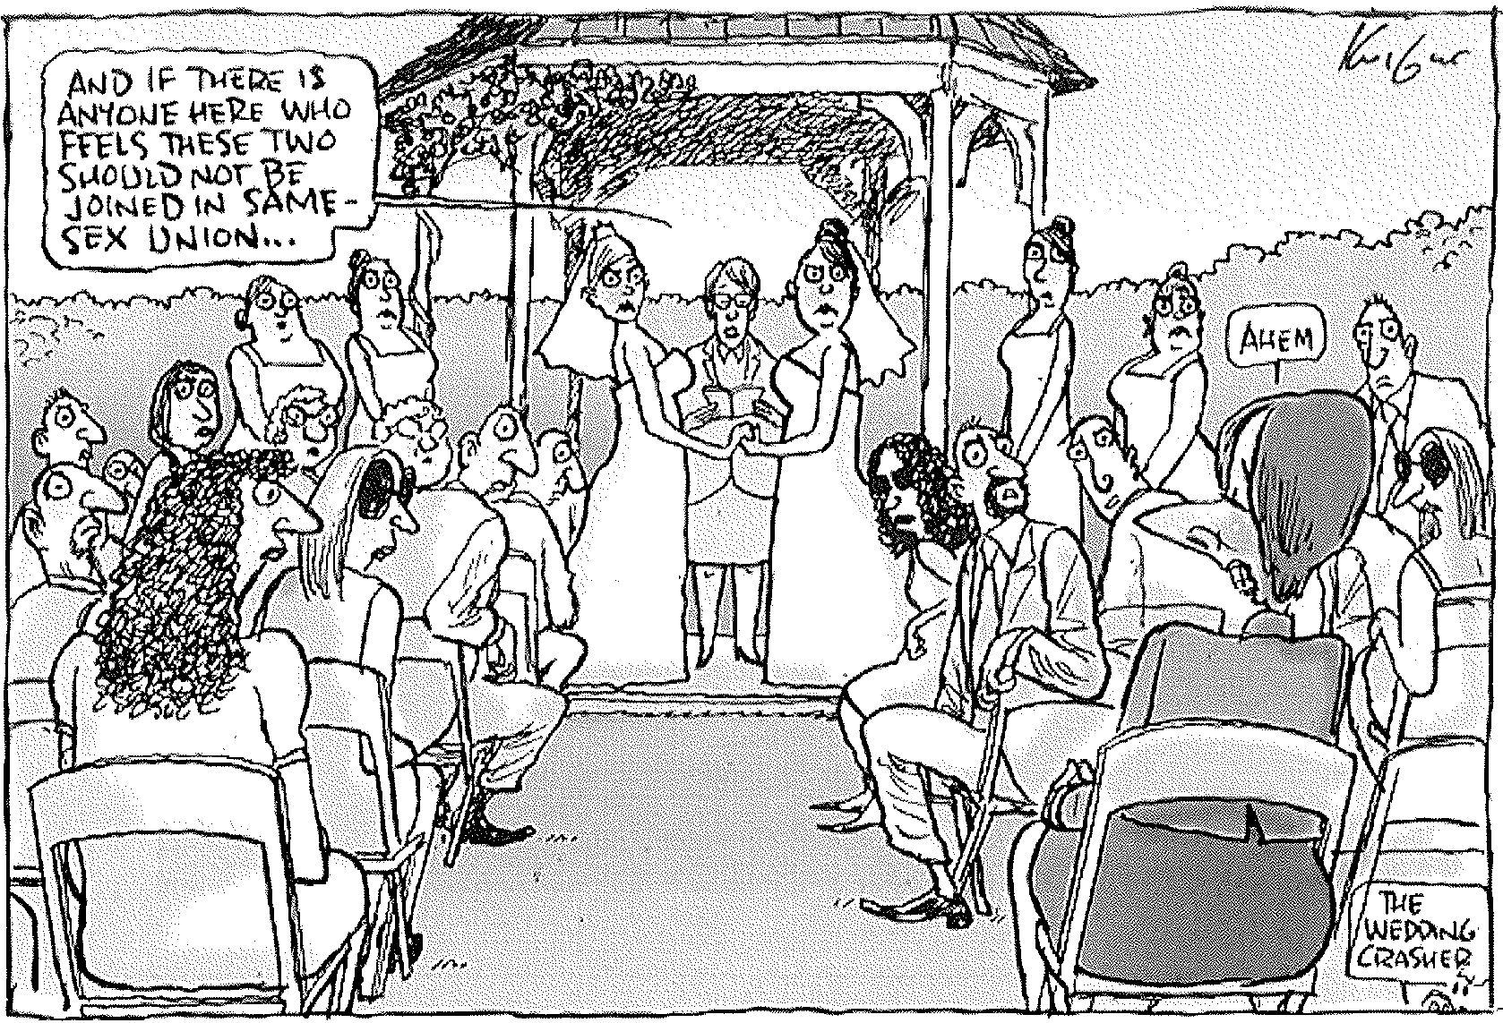

Slide 16
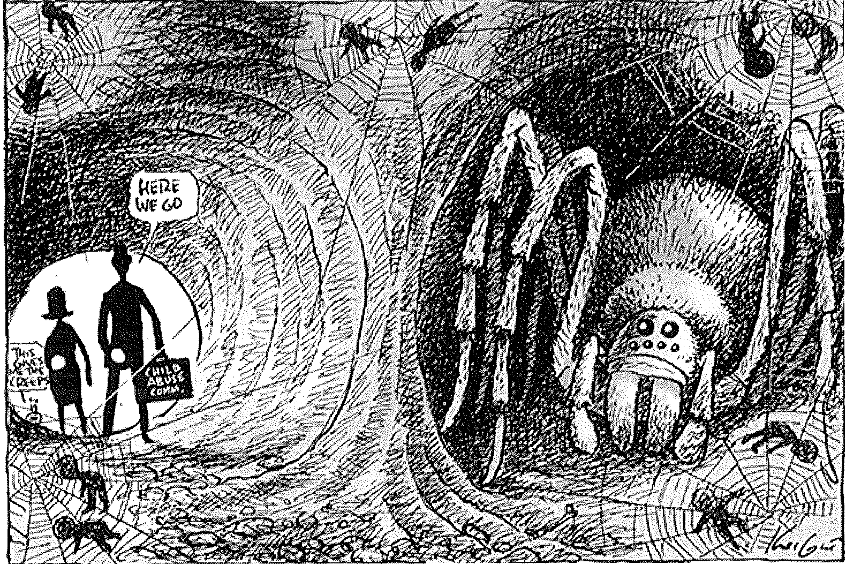

Slide 17
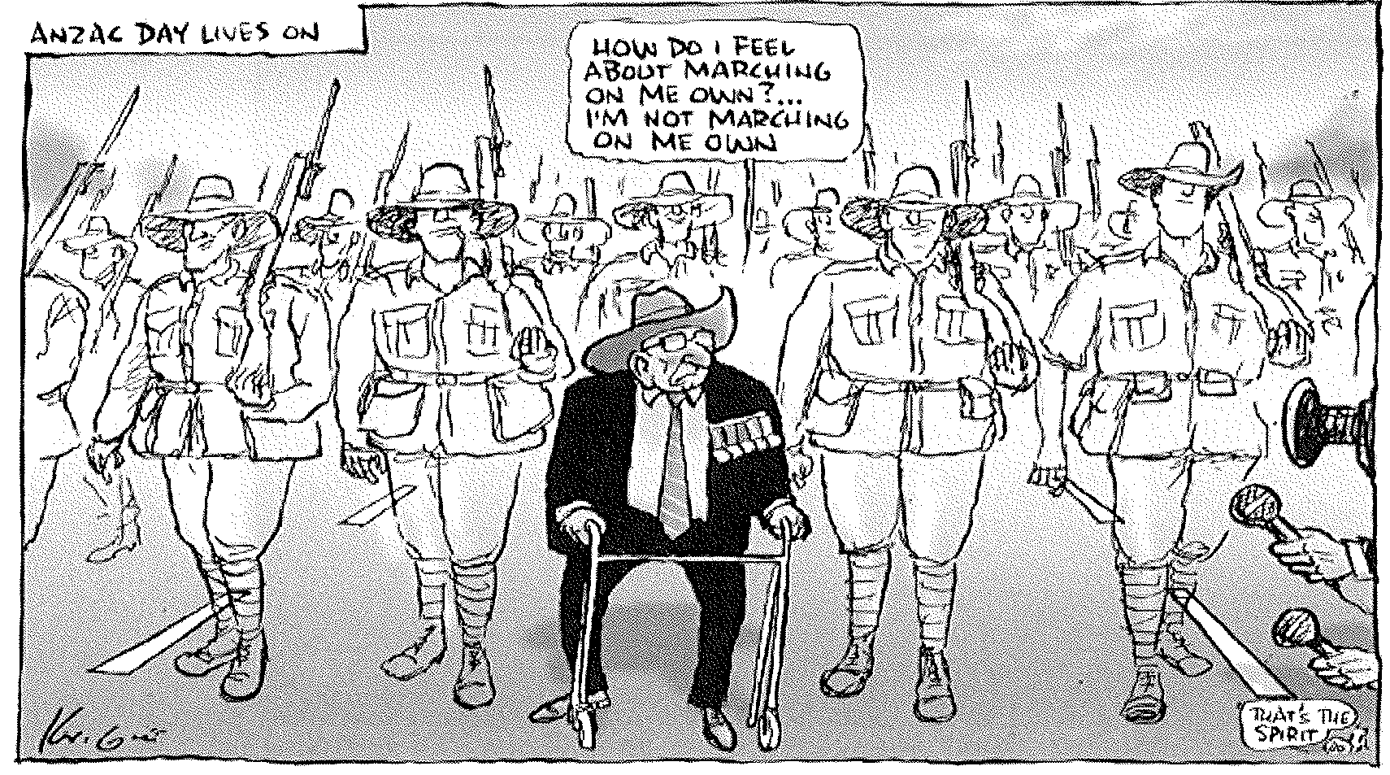

Slide 18
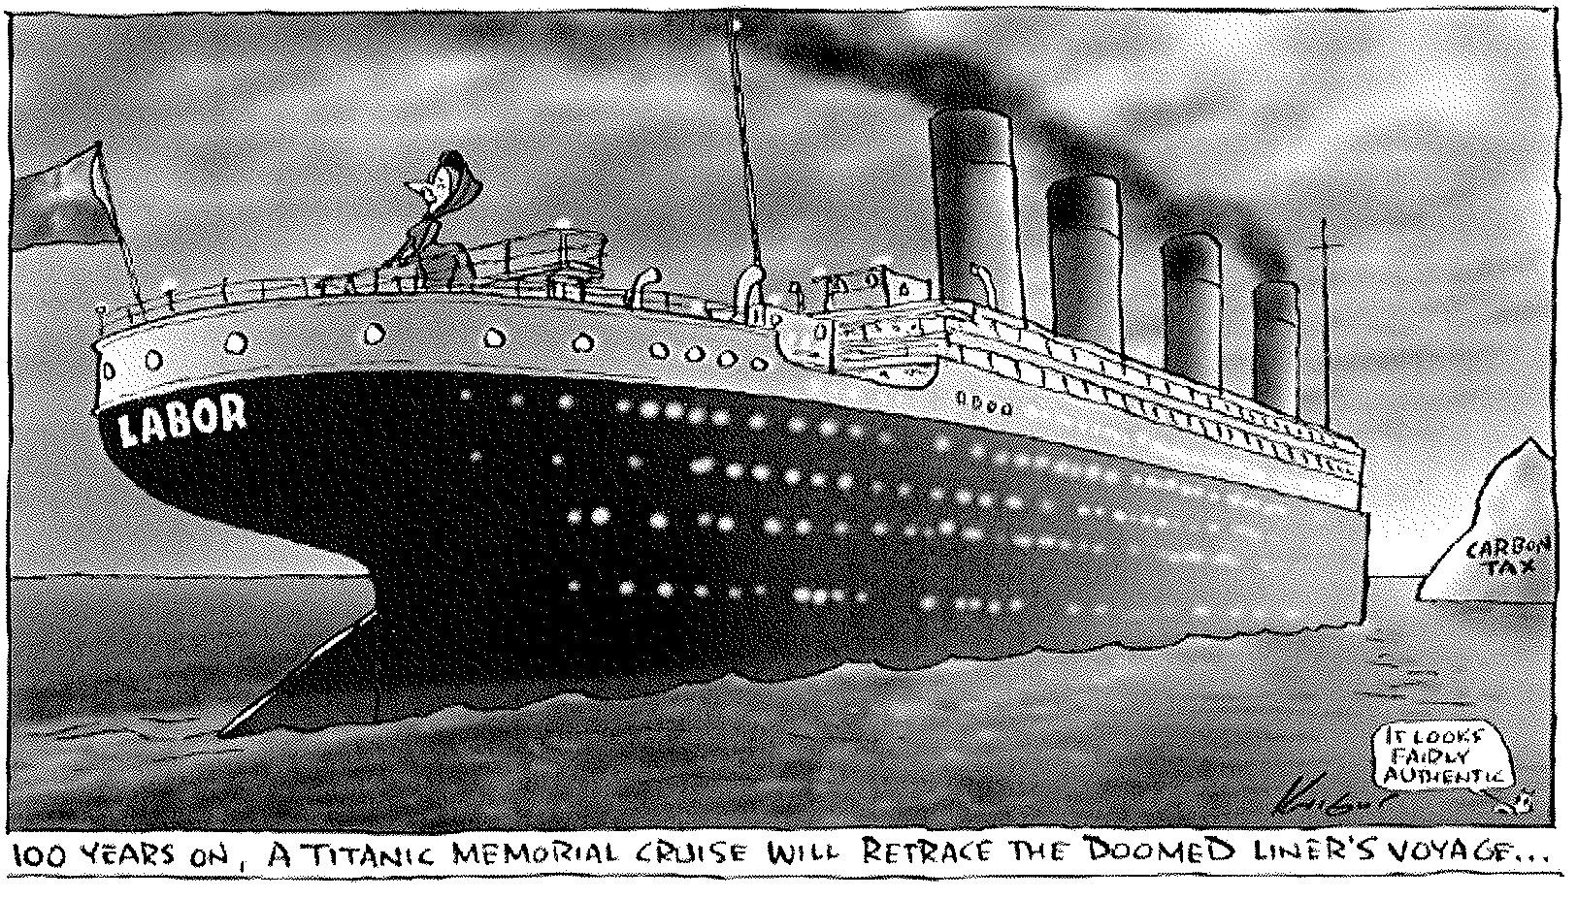

Slide 19
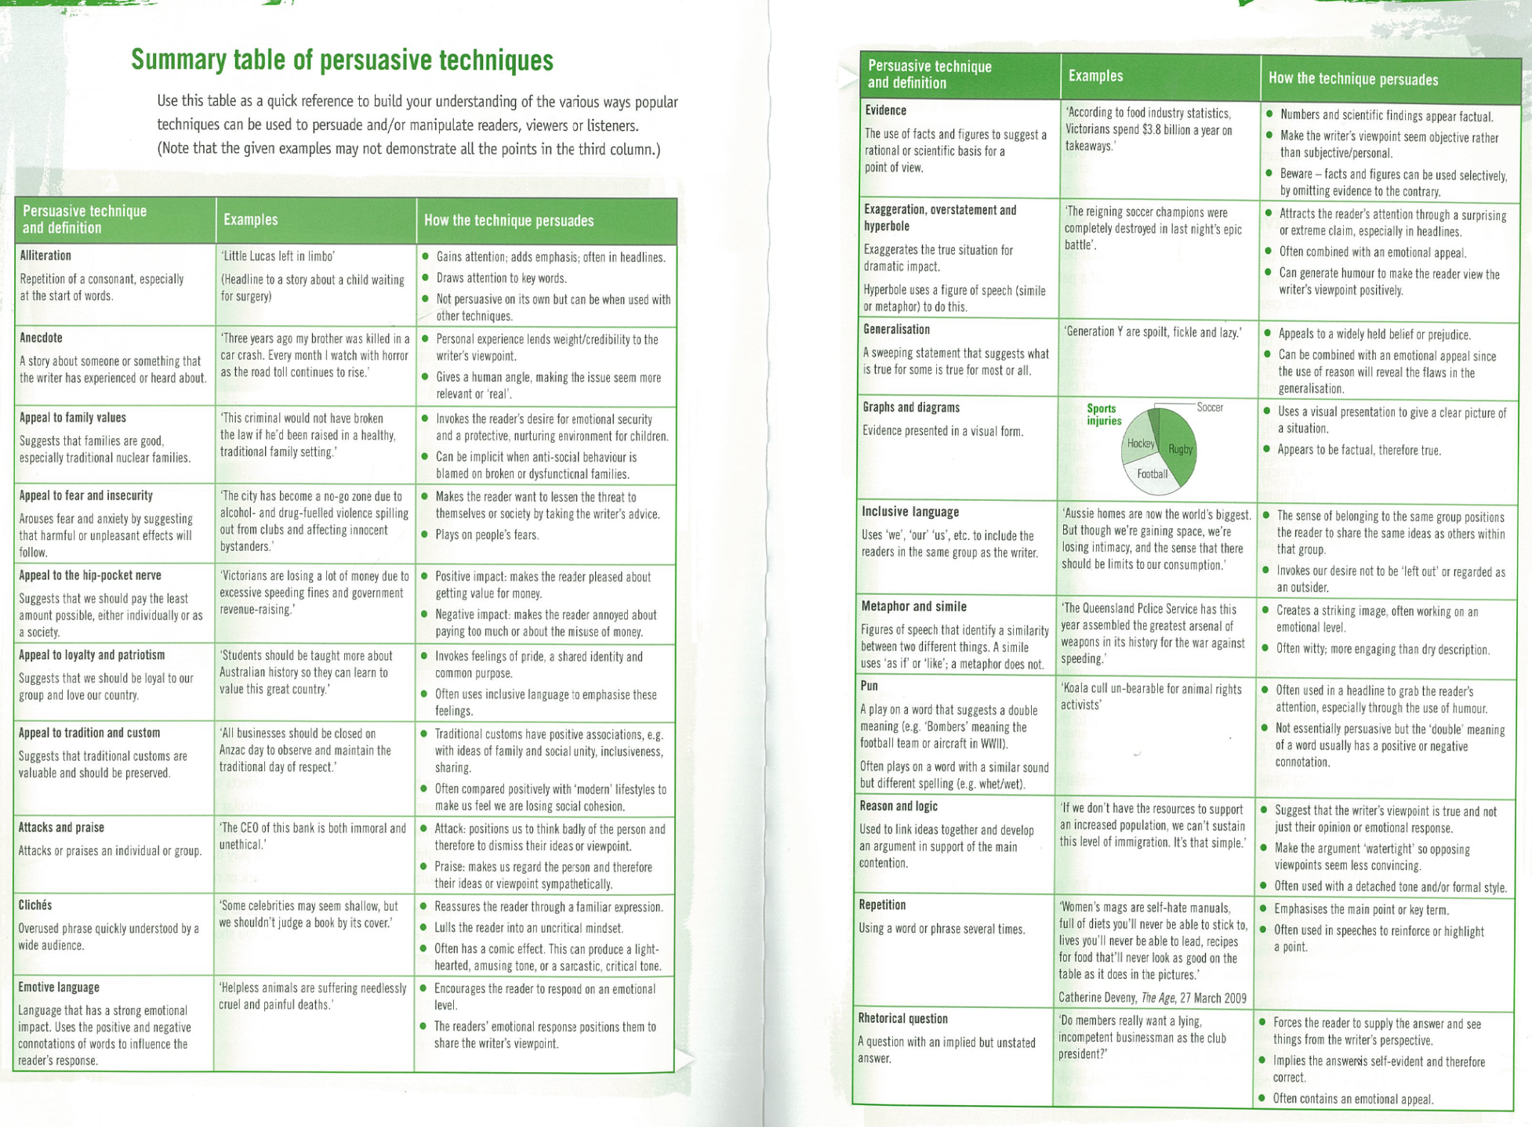

Slide 20
Past examiners reports…
2010: “students who attempted to work laboriously through every sentence found the task difficult. Students needed to choose which parts of the material they would use to explore the way in which language was being used.”
2010: “Some responses were just simple summaries or lists of the techniques used, with little development. These pieces did not score well as they did not fulfil the task.”
2011: In stronger responses, strategic selection, together with well-developed précis skills, allowed students to demonstrate their language analysis skills.

